Slide 1
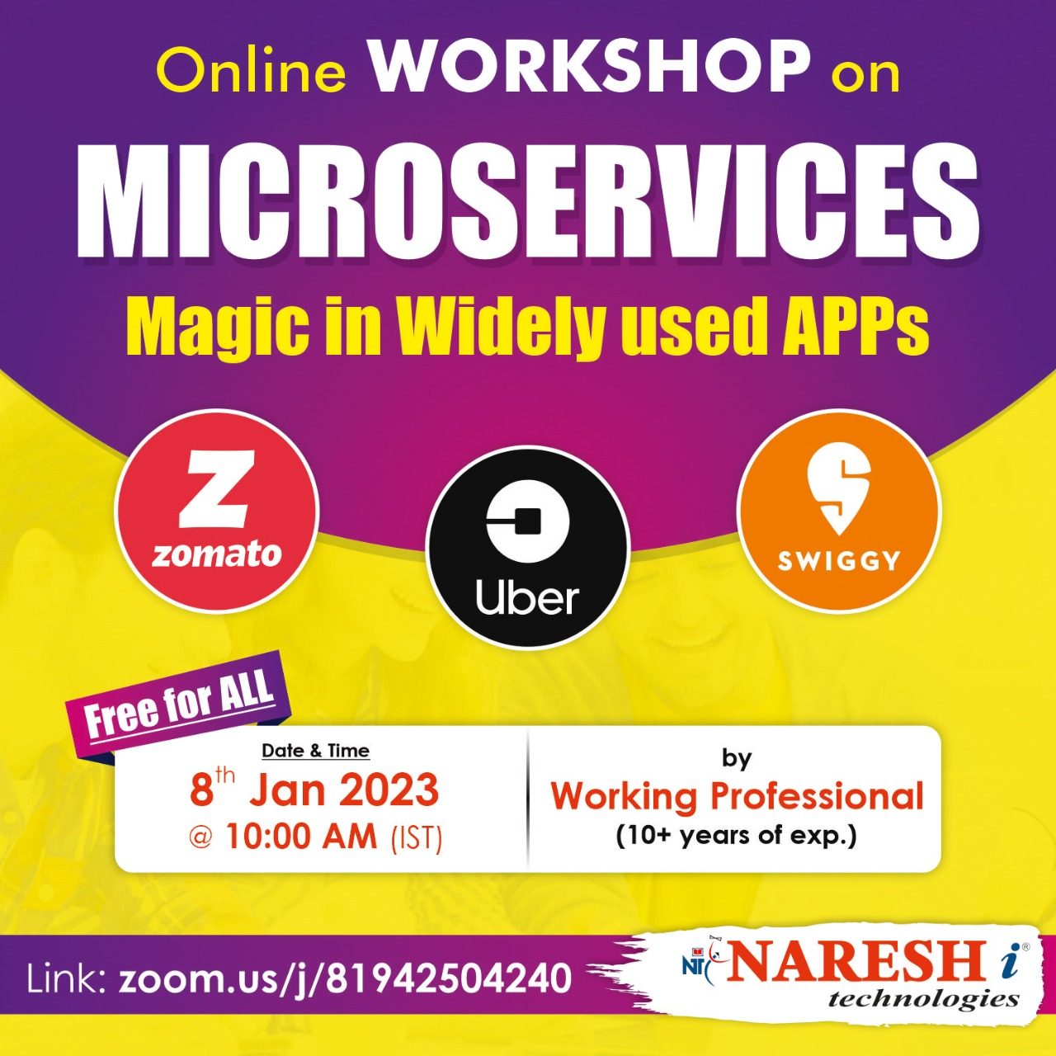

Slide 2

Dive into Microservices
~A.K GUPTHA

Slide 3
Most good programmers do programming not because they expect to get paid or get adulation by the public, but because it is fun to program.

Slide 4
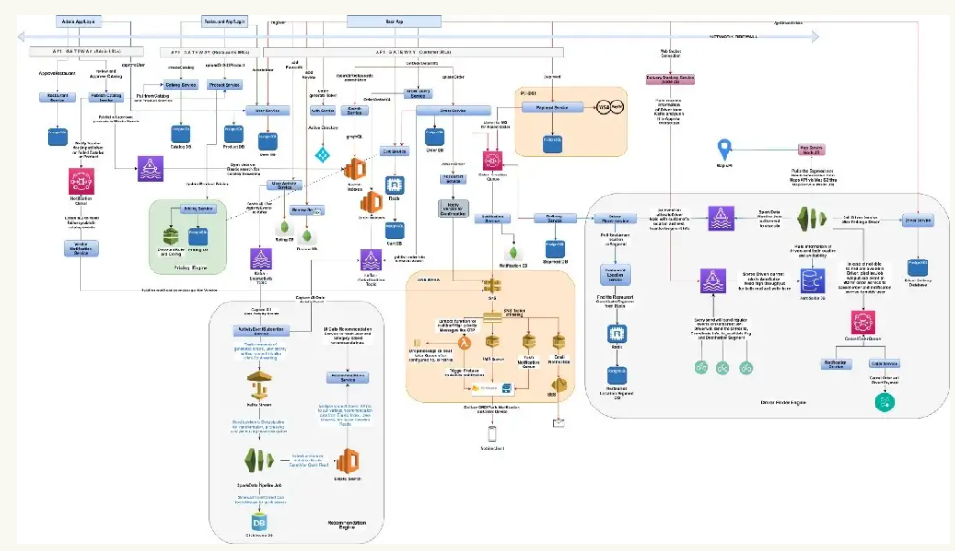

Slide 5
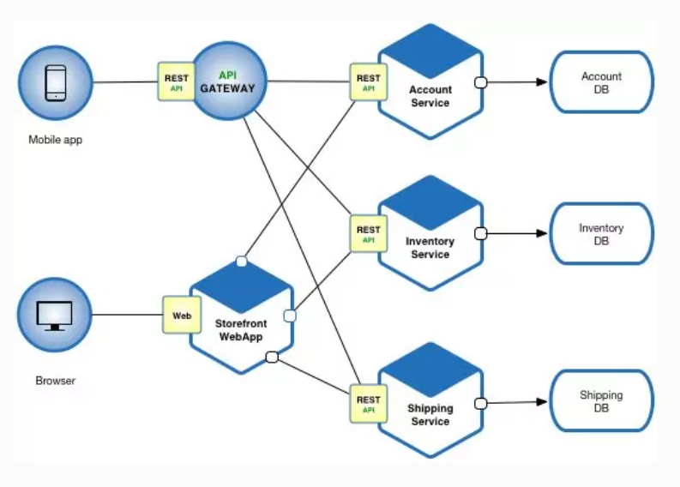
Ecommerce app architecture

Slide 6
MICRO SERVICES
WHY ?
WHAT ?
HOW ?

Slide 7
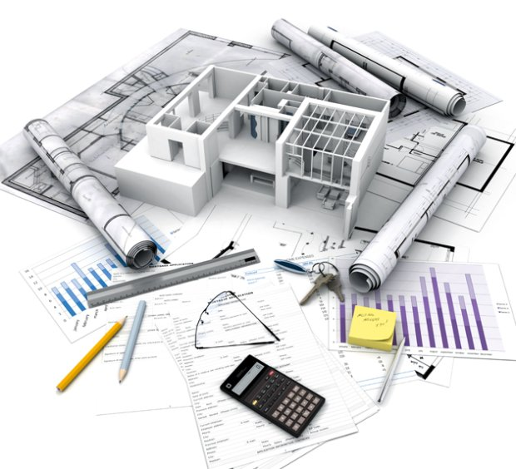
Architectural style

Slide 8

SOA
service
oriented
architecture
Modernized version of SOA
New world:
Speed of delivery
Scalability
Innovation / experimentation
Cloud / devops
Notes:
8

Slide 9
VS
monolith
microservices
Notes:
9

Slide 10
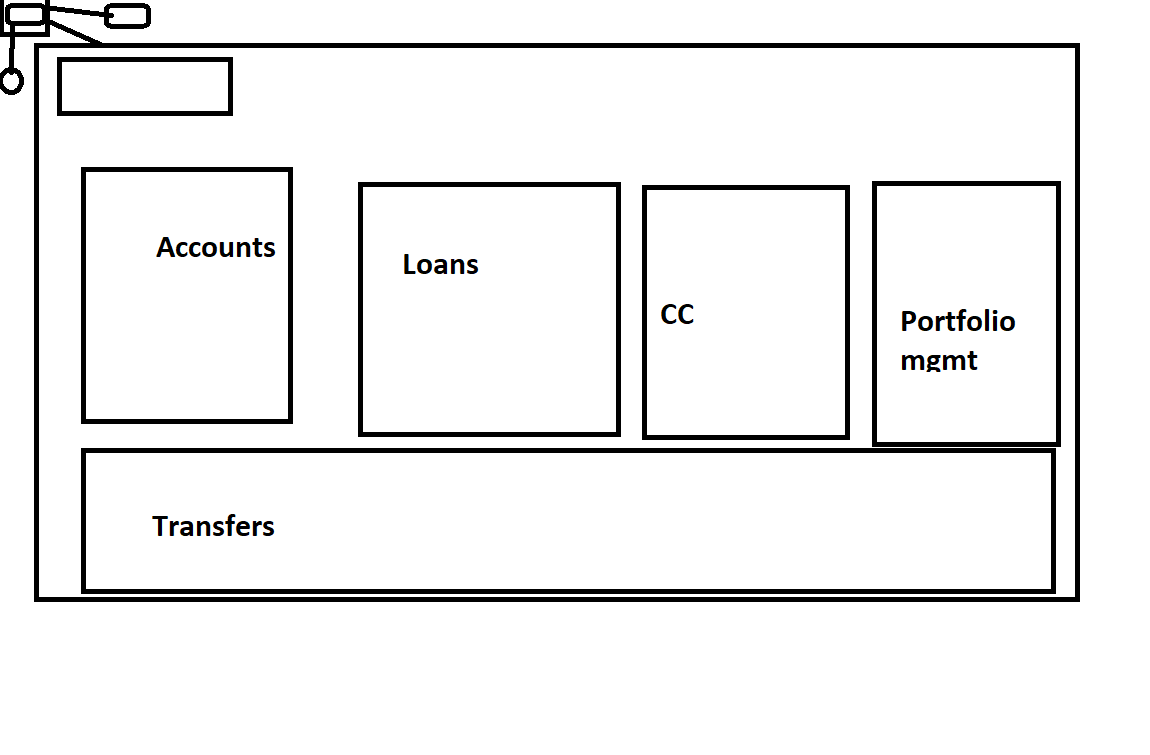

Slide 11
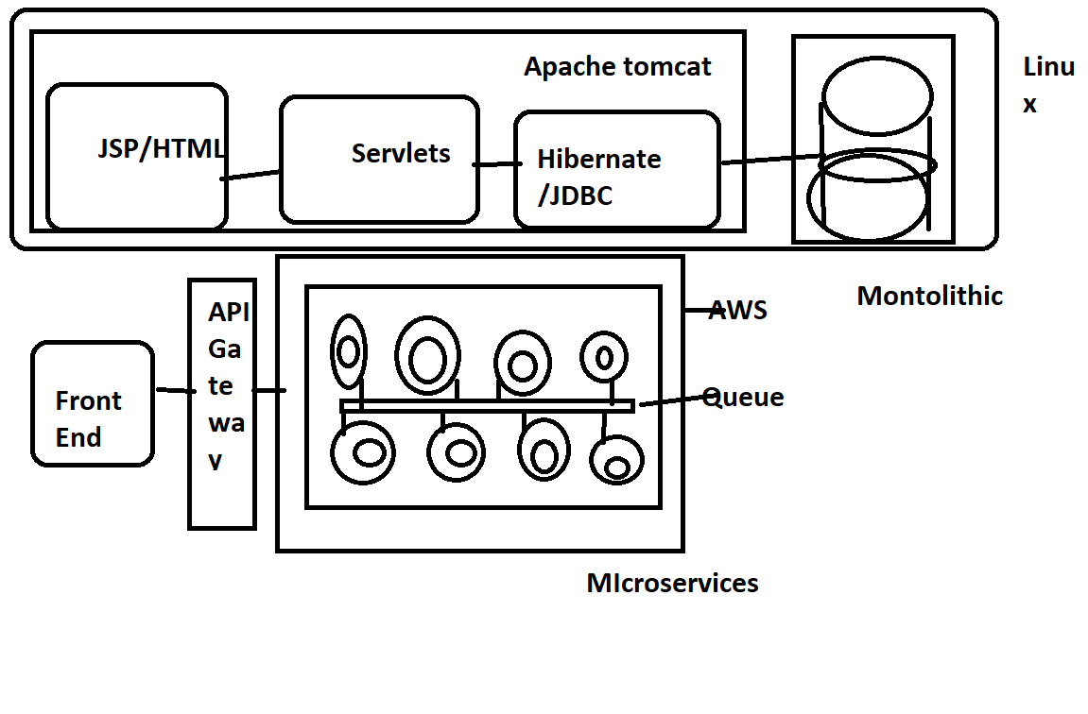

Slide 12
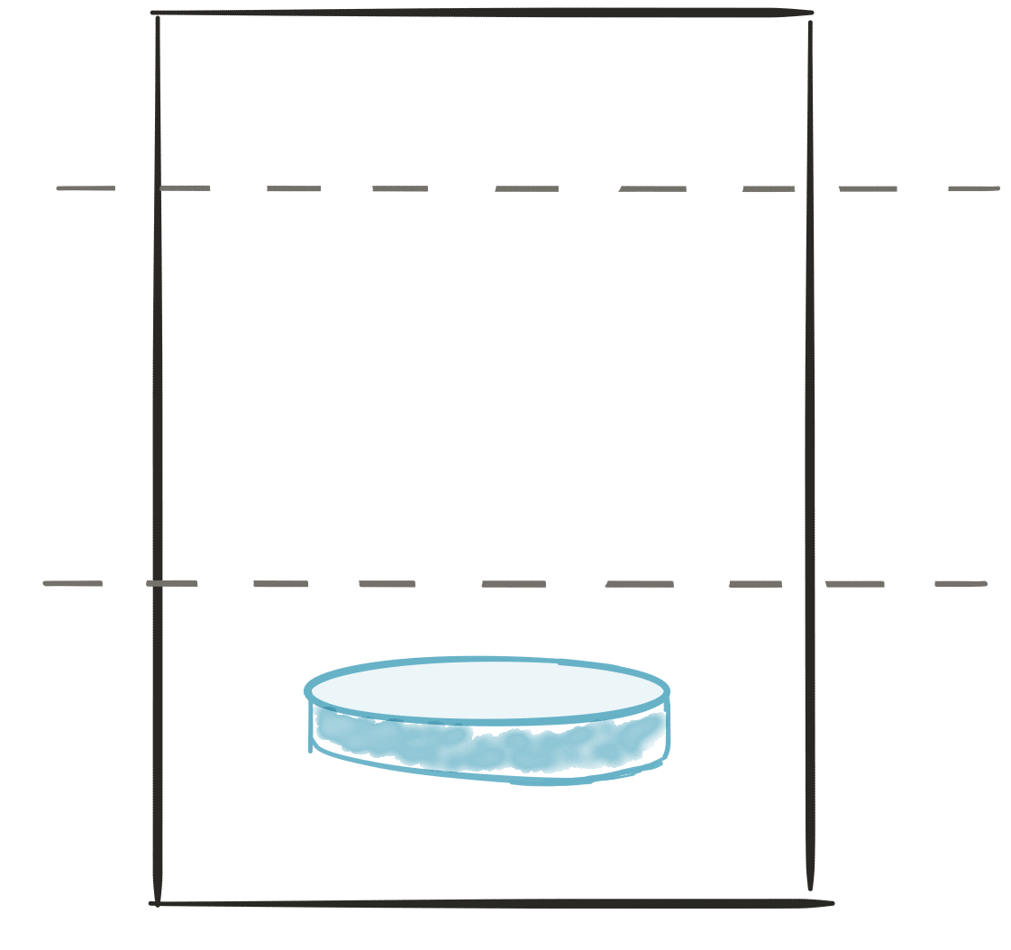
A monolith
Module
A
Module
B
Module
c
Module
D
PRESENTATION LAYER
BUSINESS LOGIC LAYER
DATABASE LAYER

Slide 13
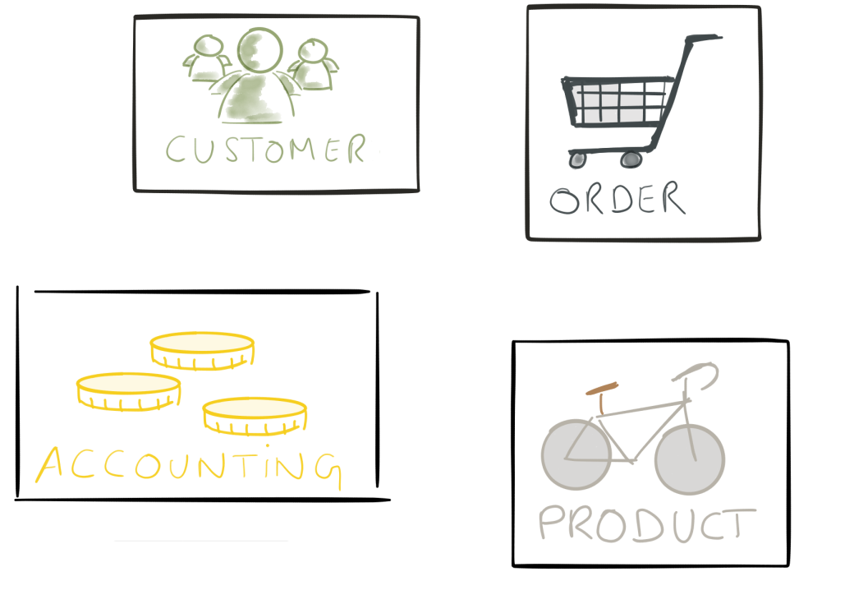
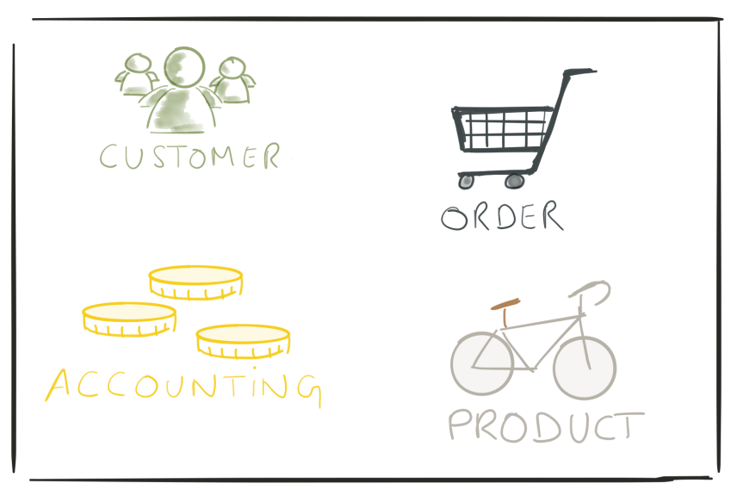
VS
monolith
microservices
Notes:
13

Slide 14
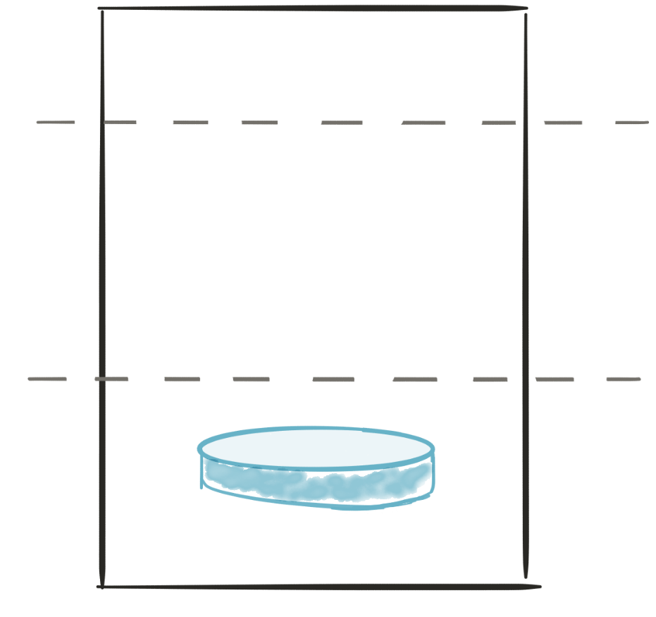
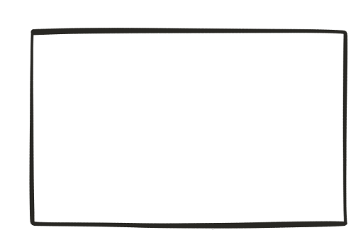
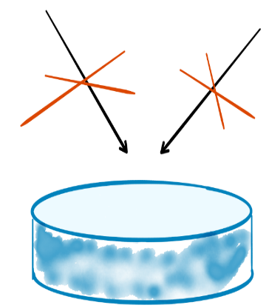
microservices
API
API
PRESENTATION LAYER
consume
Produce
BUSINESS LOGIC
LAYER
BUSINESS LOGIC LAYER
DATABASE LAYER
DATABASE LAYER
Microservice 2
Microservice 1
Notes:
14

Slide 15

principles
Modularity
Autonomous
hide implementation details
automation
Stateless
highly observable

Slide 16
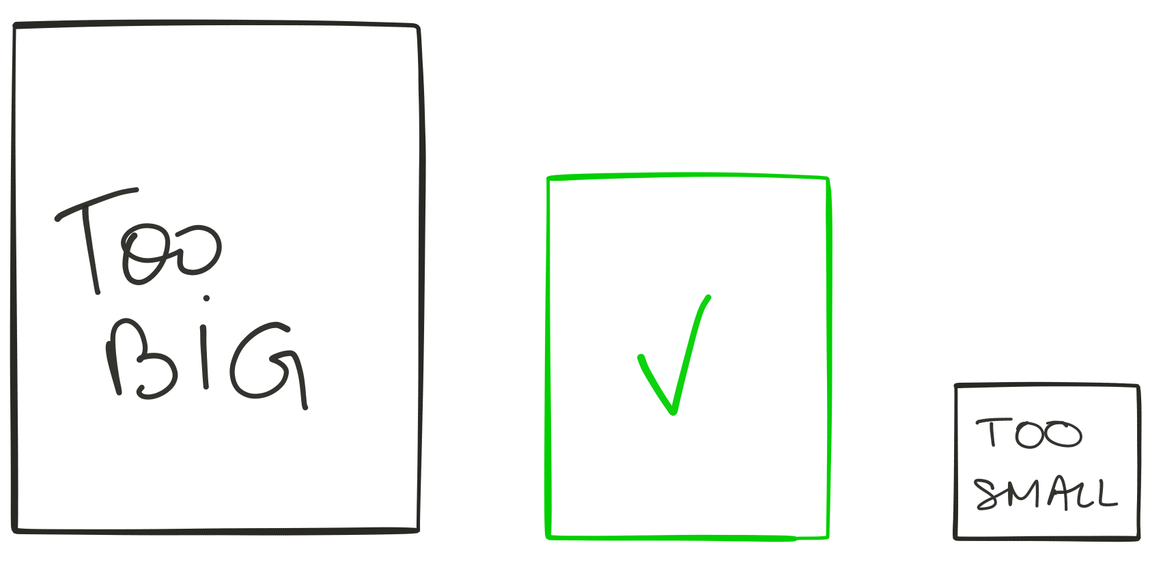
modularity

Slide 17

modularity
ModeLled around business capability
Single responsibility
Single data domain
Separation of concerns
Low coupling
Understandable by a person
Notes:
17

Slide 18
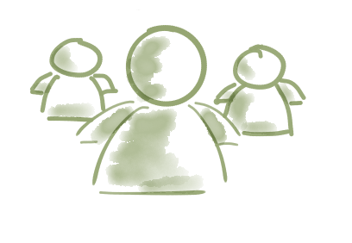
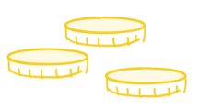

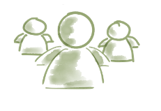


Modularity (TEAM)
A product not a project
UI - team
UI
dba
SERVER
SERVER - team
UI
dba
SERVER
Dba - team
UI
dba
SERVER
monolith
microservices

Slide 19


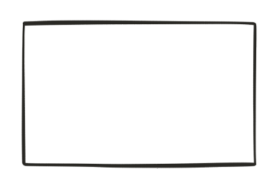
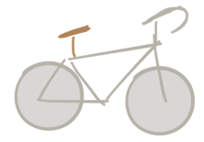
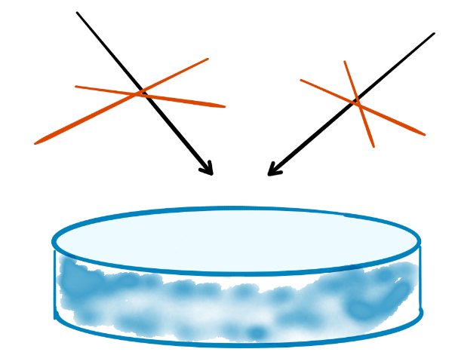
autonomous
Notes:
19

Slide 20
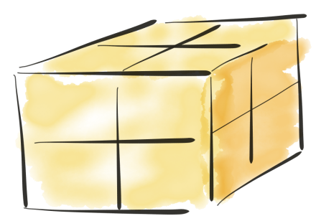
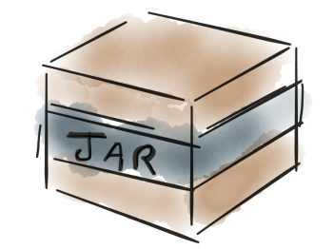

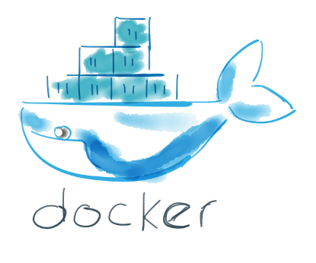

autonomous
- Libraries
- http listener
monolith
microservices

Slide 21
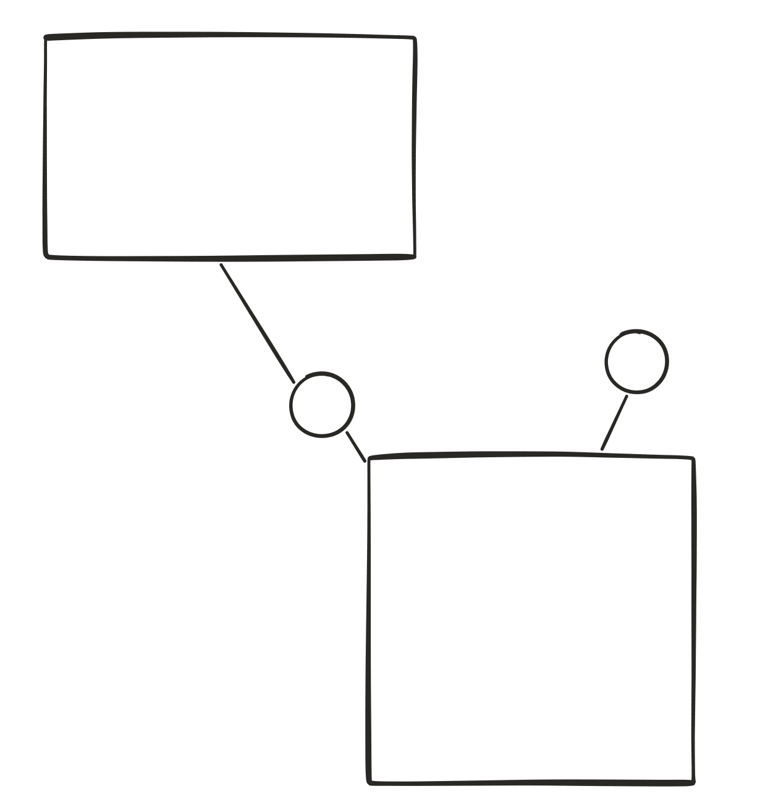

autonomous
v2
v1

Slide 22
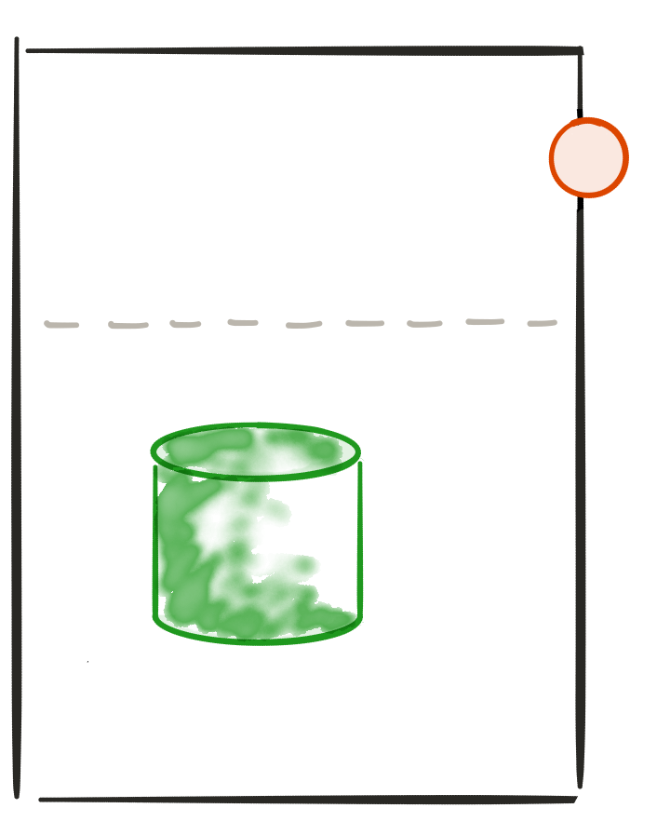
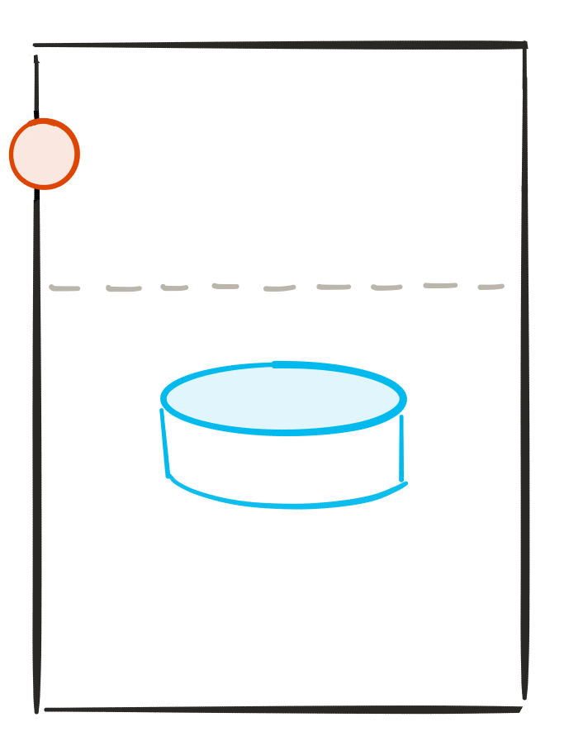
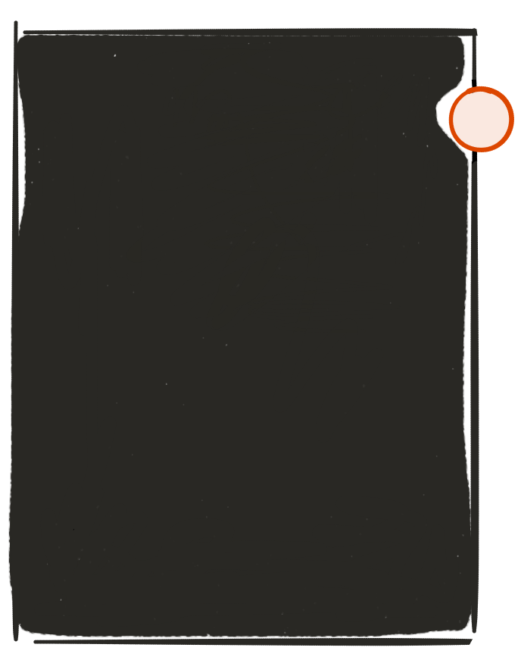





hide implementation details
API
-http
-rest
-json
API
http-
Rest-
Json-

Slide 23

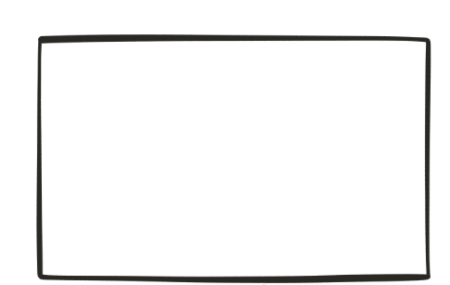
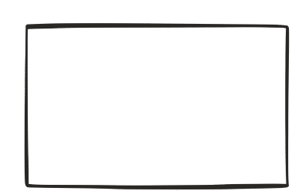

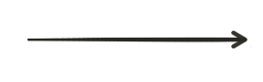
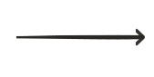
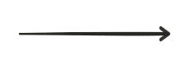
automation
Deploy
On dev/TEST
Deploy on
prod
build
testing
Continuous integration
Continuous deployment

Slide 24
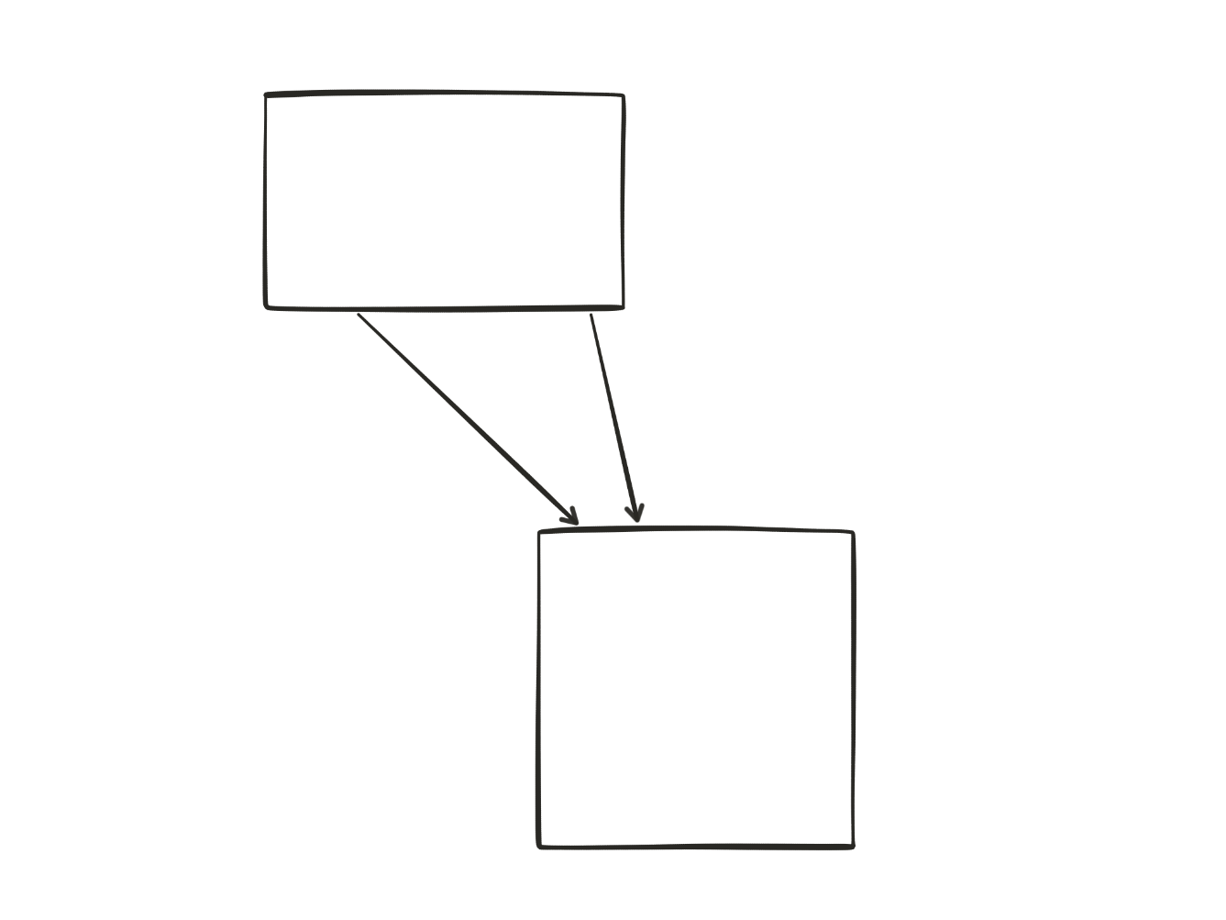
stateless
(2)
(1)
Notes:
Easier to scale / recover from failure
24

Slide 25

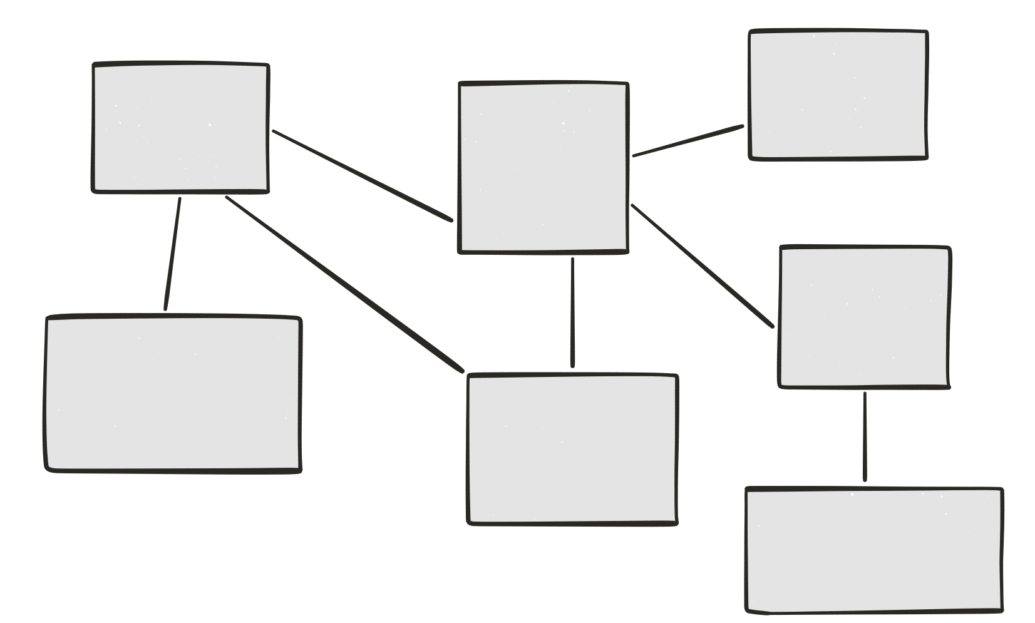
Highly observable
Logs
Notes:
25

Slide 26
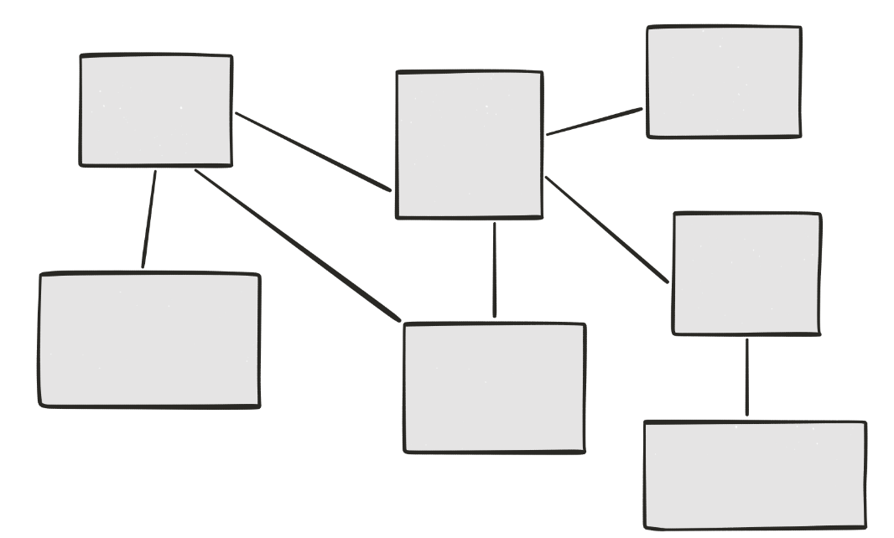

Highly observable
Centralized logging

Slide 27
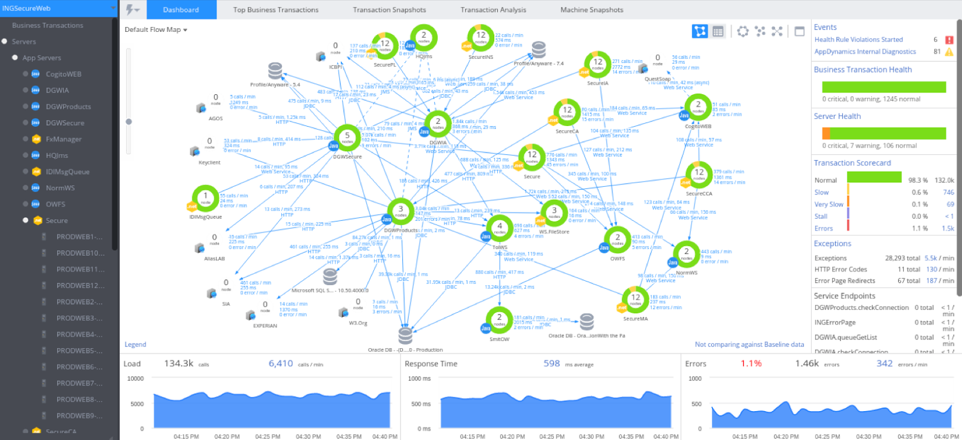

Highly observable
monitoring

Slide 28
Highly observable
Correlation ids
ID 5678
ID 5678
ID 5678
ID 5678
Notes:
28

Slide 29

principles
Modularity
Autonomous
hide implementation details
Automation
Stateless
highly observable

Slide 30
Advantages

Slide 31
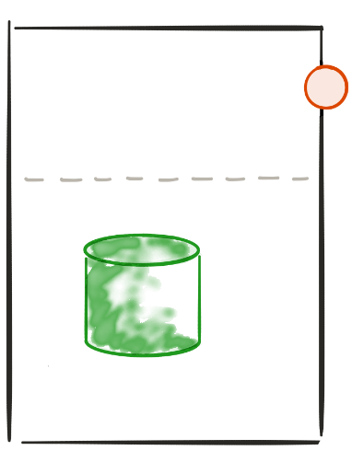
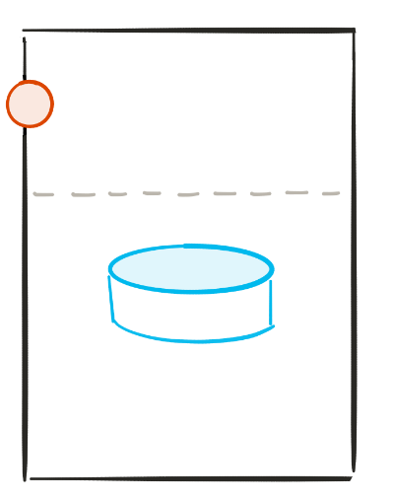


Polyglot architecture
The right technology for the job
reduce technical debt

Slide 32
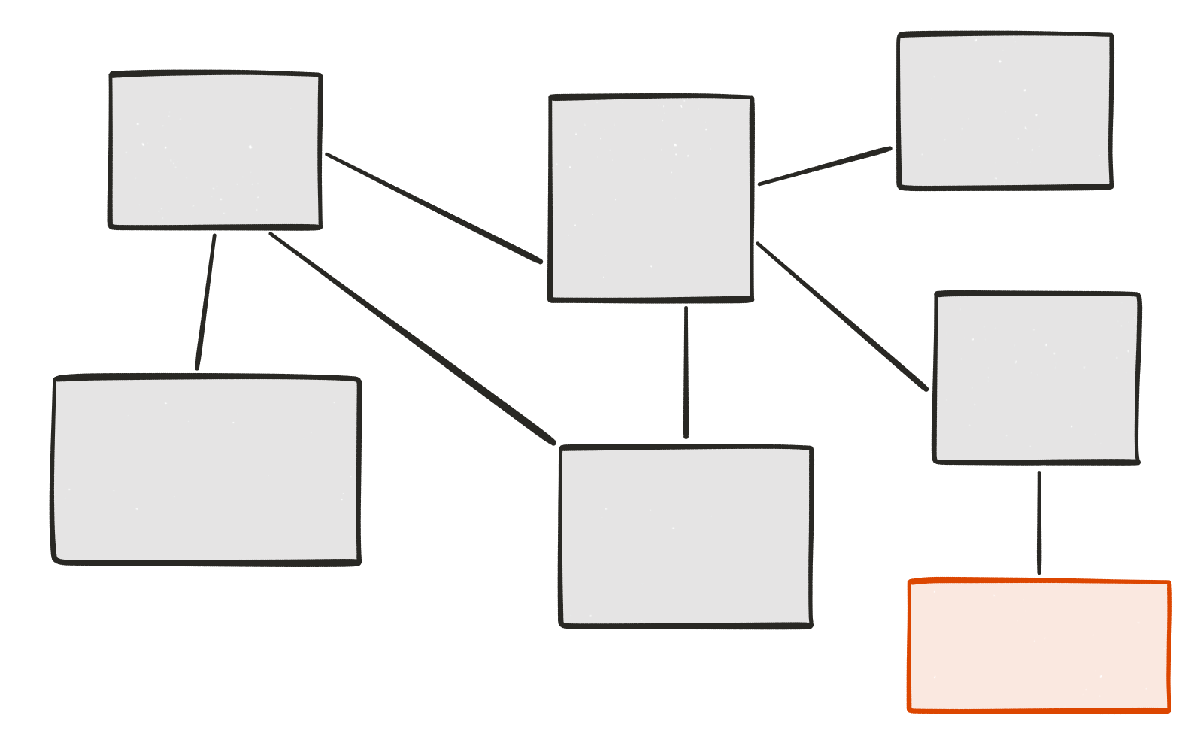
Evolutionary design
Remove
Add
Replace
Experimental microservice
Grow at “no” cost

Slide 33
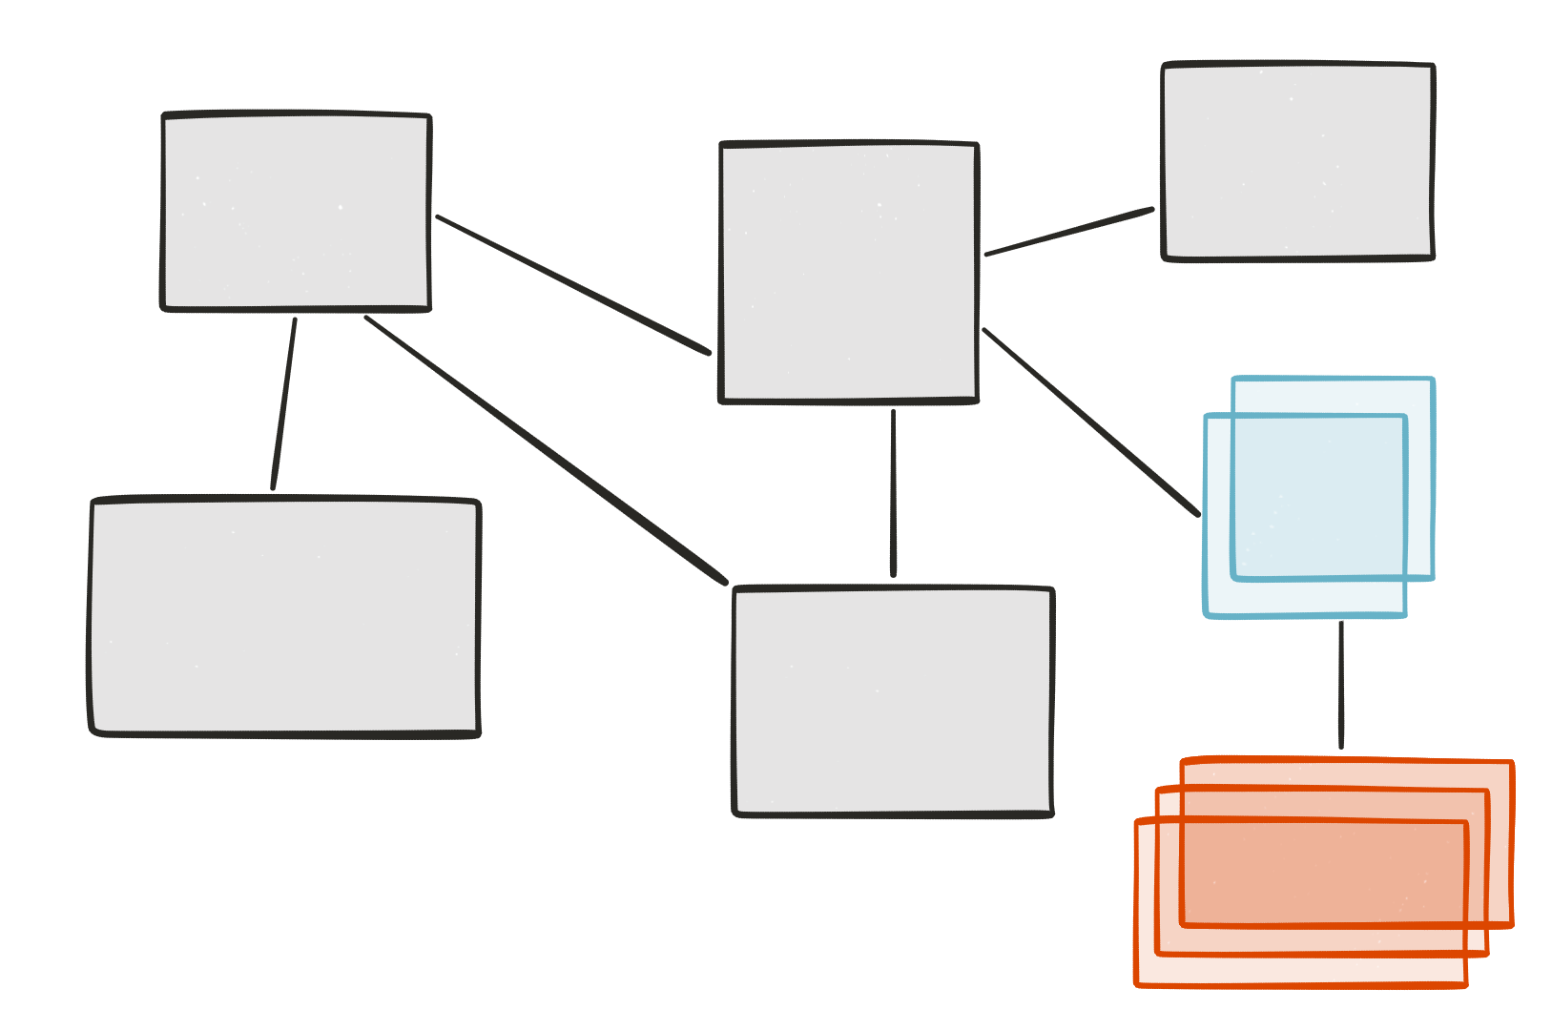
Selective scalability
Nb users > 500
Notes:
33

Slide 34
Big vs small
Smaller code base
Simpler to develop / test / deploy / scale
Start faster
Easier for new developers
Notes:
34

Slide 35
drawbacks

Slide 36
Distributed system
Consistency
Transaction
Request travelling
Slow (http)
Requires an ecosystem
Synchronous vs asynchronous
Integration tests
Conclusion:
The Microservices architecture is more complex
Than a monolith.
This the cost of growing and scaling easily
Notes:
36

Slide 37
Microservices ecosystem

Slide 38

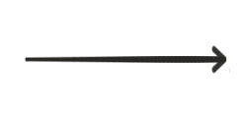

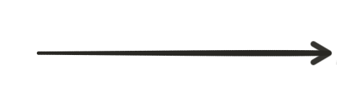
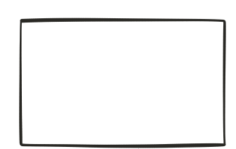
Load balancer
Load balancer

Slide 39

Load balancer (client side)
Load balancer

Slide 40
Service discovery
Service discovery
server
register
register

Slide 41
Service discovery
Service discovery
server
I want TO TALK TO THE PRODUCT SERVICE !
Here is the product service !

Slide 42
Service discovery (load balancing)
Service discovery
server
I want TO TALK TO THE PRODUCT SERVICE !
Here is one instance of product service !

Slide 43
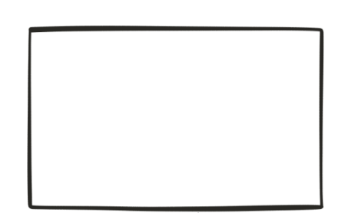

Api Gateway
Browser UI
e.g. angular 2
Mobile app
API Gateway
e.G. (ZUUL)
Notes:
API gateway
Insulates the clients from how the application is partitioned into microservices
insulate the clients from the problem of determining the locations of service instances
Provides the optimal API for each client
Reduces the number of requests / roundtrips.
Backend for front end
43

Slide 44
This is not new!
The old new thing...
Principles
Modularity
Autonomous
hide implementation details
Automation
Stateless
highly observable
advantages
Polyglot architecture
Evolutionary design
Selective scalability
Big vs small
drawbacks
Distributed system
Synchronous vs asynchronous
Slow (http)
Requires an ecosystem
ecosystem
Load balancer
Service discovery
api gateway

Slide 45
12 Factor Apps
https://12factor.net/

Slide 46
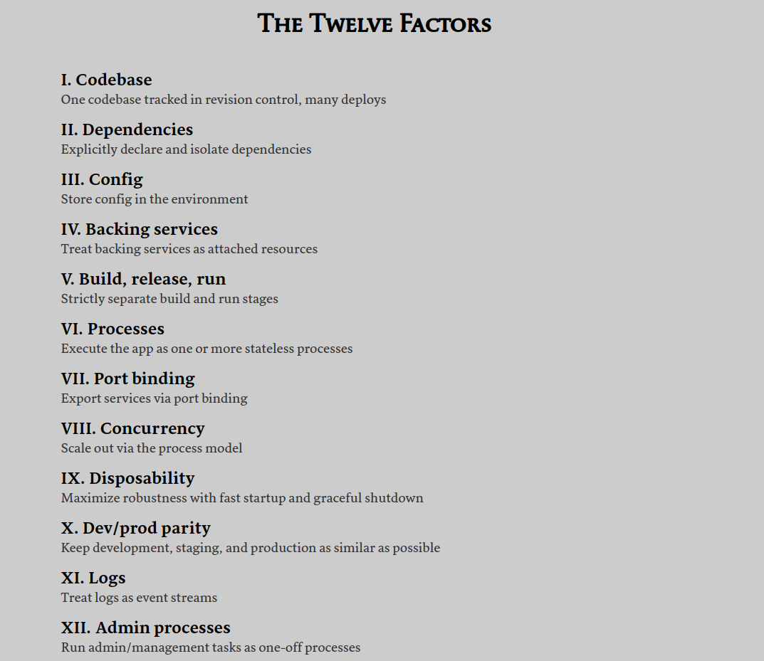

Slide 47
THANKS !

